Slide 1
Operating System and
System Programming
Software College of SCU
四川大学软件学院 左航

Slide 2
Unit 8. Optimizing Program Performance
8.1 Introduction of Optimizing Program
8.2 The Golden Rules of Optimization
8.3 Optimizing Compilers
8.4 General Optimization Techniques
8.5 Example of Optimizing Program
201001V1.1

Slide 3
8.1 Introduction of Optimizing Program(1/4)
This unit is about making programs run fast.
  Usually speed is not the most important concern while writing a program.
  The professional programmer is usually most concerned with making a program that is easy to write, debug, and maintain.
201001V1.1

Slide 4
8.1 Introduction of Optimizing Program(2/4)
Procedure of Developing a Program
Why not
A complicate, fast
program ?
A slow but correct
Program
Modify the program
To make it faster
201001V1.1

Slide 5
8.1 Introduction of Optimizing Program(3/4)
A correct program, even if slow, computes right answers faster than a program that is not. It is often better to use a simple but slow algorithm.
  Fast programs often take much more time to develop, and they are useless until they are finished.
  Speed improvements of less than a factor of two(两倍) are barely noticeable to users in an interactive setting.
  Computer technology changes so fast that improvements in speed can often be obtained simply by waiting for the next generation of hardware.
201001V1.1

Slide 6
8.1 Introduction of Optimizing Program(4/4)
Optimize at multiple levels:
  Code adjustment
    Data Representations
    Procedures
    Loops
    …
  New perspective
    Algorithm
201001V1.1

Slide 7
Unit 8. Optimizing Program Performance
8.1 Introduction of Optimizing Program
8.2 The Golden Rules of Optimization
8.3 Optimizing Compilers
8.4 General Optimization Techniques
8.5 Example of Optimizing Program
201001V1.1

Slide 8
8.2 The Golden Rules of Optimization (1/4)
Good Algorithms Rule
  The best and most important way of optimizing a program is using good algorithms
  time complexity时间复杂度
    E.g. O (n* log n) rather than O(n²)
  space complexity空间复杂度 (not discussed here)
201001V1.1
Notes:
算法的时间复杂度

Slide 9
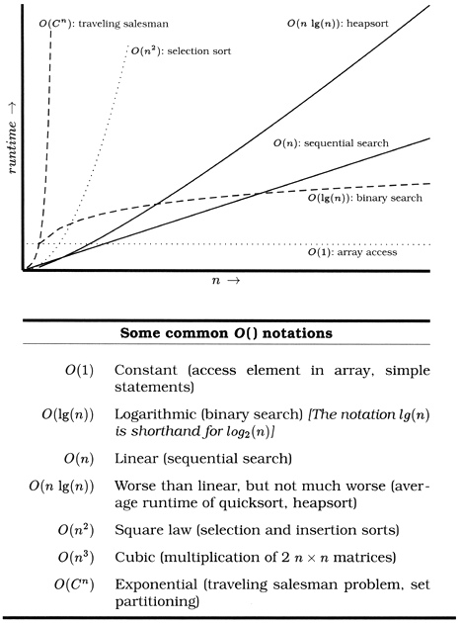
8.2 The Golden Rules of Optimization (2/4)
常数阶O(1),对数阶O(log2n),
线性阶O(n),
线性对数阶O(nlog2n),
平方阶O(n^2)，
立方阶O(n^3),...，
201001V1.1
Notes:
常数阶O(1),对数阶O(log2n),线性阶O(n),
线性对数阶O(nlog2n),平方阶O(n^2)，立方阶O(n^3),...，

Slide 10
8.2 The Golden Rules of Optimization (3/4)
However, we still need lower level optimization to get more of our programs
In addition, asymptotic complexity(时间复杂度) is not always an appropriate metric of efficiency
  Hidden constant may be misleading
    E.g. a linear time algorithm than runs in 100*n+100 time is slower than a cubic time algorithm than runs in n³+10 time if the problem size is small (n=10)
201001V1.1

Slide 11
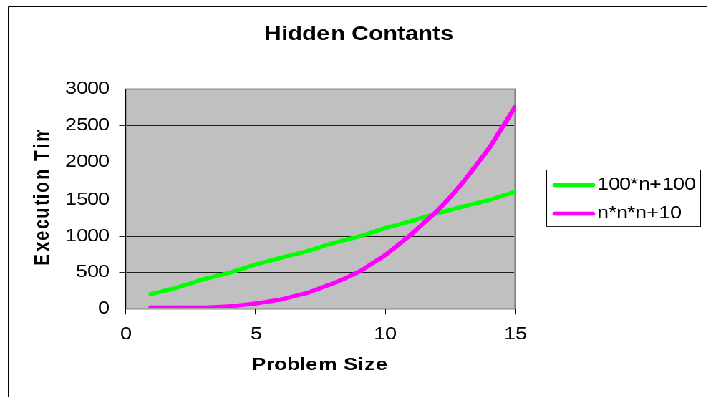
8.2 The Golden Rules of Optimization (4/4)
Asymptotic Complexity: Hidden Constants
201001V1.1

Slide 12
Unit 8. Optimizing Program Performance
8.1 Introduction of Optimizing Program
8.2 The Golden Rules of Optimization
8.3 Optimizing Compilers
8.4 General Optimization Techniques
8.5 Example of Optimizing Program
201001V1.1

Slide 13
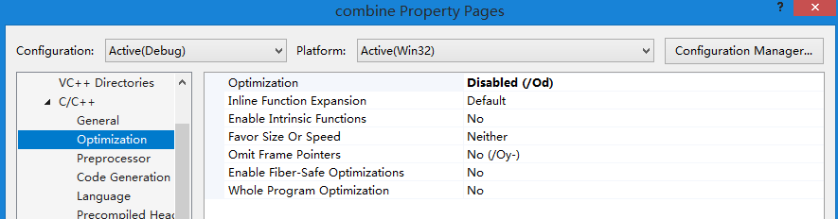
8.3 Optimizing Compilers(1/5)
Capabilities of Optimizing Compilers
  Provide efficient mapping of program to machine
    register allocation
    code selection and ordering
    eliminating minor inefficiencies
201001V1.1
Notes:
Peephole观察孔 Reference
http://en.wikipedia.org/wiki/Optimizing_compiler
Peephole optimizations/Local optimizations/Global optimizations /Loop optimizations/Interprocedural, whole-program or link-time optimization /Machine code optimization

Slide 14
8.3 Optimizing Compilers(2/5)
Limitations of Optimizing Compilers
  Compilers have difficulty overcoming “optimization blockers(妨碍优化的因素)”
Optimization Blockers
  potential memory aliasing (存储器别名使用)
  potential procedure side-effects (函数副作用)
201001V1.1

Slide 15
8.3 Optimizing Compilers(3/5)
memory aliasing
  编译器必需假设不同的指针可能会指向存储器的同一位置，造成了妨碍优化的因素。
1 void twiddle1(int *xp, int *yp)
2 {
3 *xp += *yp;
4 *xp += *yp;
5 }
6
7 void twiddle2(int *xp, int *yp)
8 {
9 *xp += 2* *yp;
10 }
Q1: Which one is more efficient?
2, 三次存储器引用，read *xp, read *yp, write *xp
Q2：Does the twiddle1 have the same behavior as twiddle2?
Q3: If xp and yp are equal, what are the results?
X=Y,twiddle1的xp增加4倍，twiddle2的xp增加3倍。
201001V1.1

Slide 16
8.3 Optimizing Compilers(4/5)
procedure side-effects
  编译器不会判断一个函数是否有副作用，它会假设最糟的情况，并保持所有的函数调用不变
1 int f(int);
2
3 int func1(x) {
4 return f(x) + f(x) + f(x) + f(x);
5 }
6
7 int func2(x) {
8 return 4*f(x);
9 }
Q1: Which one is efficient?
Q2: Do they have same result?
Q3: What are the results if the following code for f is:
1 int counter = 0;
2
3 int f(int x) {
4 return counter++;
5 }
f() will modify the global variable which causes side-effect.
201001V1.1

Slide 17
8.3 Optimizing Compilers(5/5)
Using inline function to improve
1 int counter = 0;
2
3 inline int f() {
4 return counter++;
5 }
1 int func1in() {
2 int t = counter++; /*+0*/
3 t += counter++; /*+1*/
4 t += counter++; /*+2*/
5 t += counter++; /*+3*/
6 return t;
7 }
1 int func1opt() {
2 int t = 4*counter+6;
3 counter = counter+4;
4 return t;
5 }
201001V1.1

Slide 18
Unit 8. Optimizing Program Performance
8.1 Introduction of Optimizing Program
8.2 The Golden Rules of Optimization
8.3 Optimizing Compilers
8.4 General Optimization Techniques
8.5 Example of Optimizing Program
201001V1.1

Slide 19
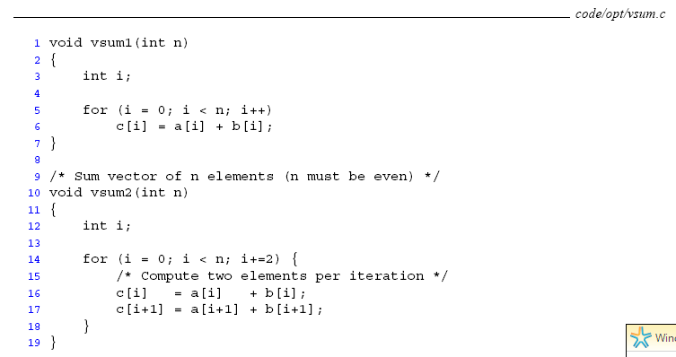
8.5 Example of Optimizing Program (1/24)
Expressing Program Performance
201001V1.1

Slide 20
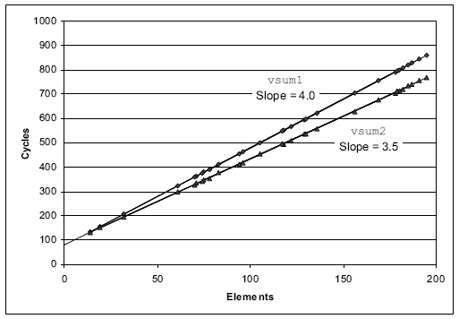
8.5 Example of Optimizing Program (2/24)
vsum1: 80 + 4.0n CPE = 4.0
vsum2: 83.5 + 3.5n CPE = 3.5
每个元素花费的时钟周期 cycle per element
201001V1.1

Slide 21
8.5 Example of Optimizing Program (3/24)
Expressing Program Performance
  cycles per element (CPE)
    CPE: 每元素的周期数
    我们关心的是:给定的向量长度,程序运行的速度如何.
    不是使用每次循环的周期数来度量
      这是因为象循环展开这样的技术使得我们能用比较少的循环完成计算
    How to get CPE?
      最小二乘方拟合
201001V1.1

Slide 22
8.5 Example of Optimizing Program (4/24)
In this example, we will see a program of vector
  Data structure
  Some functions of this vector
    Among them, the combine() function is the one that need to be optimized
      Combine1() : without optimization
      Combine2() : Eliminating Loop Inefficiencies
      Combine3() : Reducing Procedure Calls
      Combine4(): Eliminating Unneeded Memory References
      Combine5(): Unrolling Loop by 3
      Combine6() Combine7(): Parallelism
201001V1.1

Slide 23
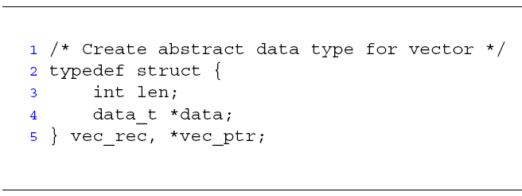
8.5 Example of Optimizing Program (5/24)
length
0
1
2
length–1
data
• • •
201001V1.1

Slide 24
8.5 Example of Optimizing Program (6/24)
Functions
  vec_ptr new_vec(int len)
    Create vector of specified length
  int get_vec_element(vec_ptr v, int index, int *dest)
    Retrieve vector element, store at *dest
    Return 0 if out of bounds, 1 if successful
  int vec_length(vec_ptr v)
    Return the length of the vector
201001V1.1

Slide 25
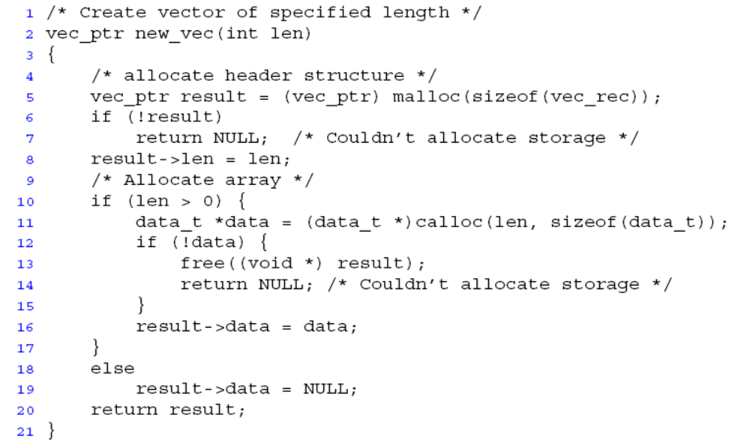
8.5 Example of Optimizing Program (7/24)
201001V1.1

Slide 26
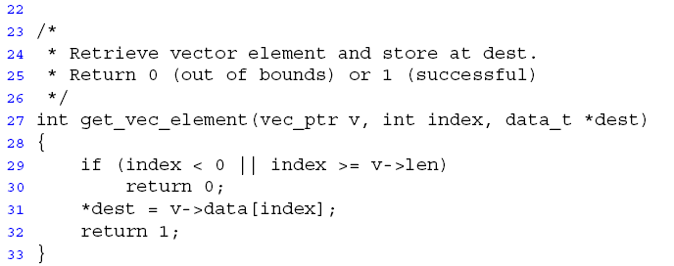
8.5 Example of Optimizing Program (8/24)
201001V1.1

Slide 27
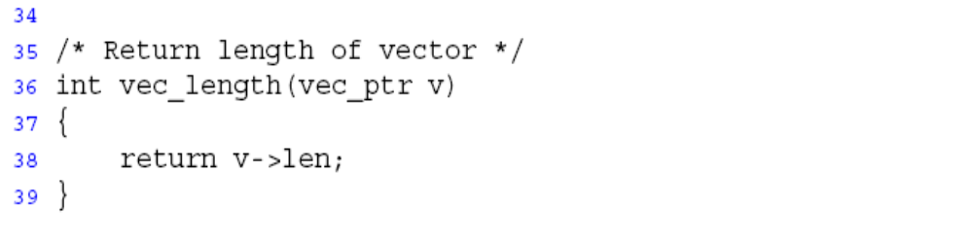
8.5 Example of Optimizing Program (9/24)
201001V1.1

Slide 28
8.5 Example of Optimizing Program (10/24)
Function combine1
  Compute sum of all elements of vector
  Store result at destination location
void combine1(vec_ptr v, int *dest)
{
int i;
*dest = 0;
for (i = 0; i < vec_length(v); i++) {
int val;
get_vec_element(v, i, &val);
*dest = *dest OP val;
}
}
CPE(每元素的周期数): 31.25
201001V1.1
Notes:
1)CPE: 每元素的周期数, 不是使用每次循环的周期数来度量,这是因为象循环展开这样的技术使得我们能用比较少的循环完成计算,而我们关心的是, 给定的向量长度,程序运行的速度如何.
2)循环低效率的极端例子

Slide 29
8.5 Example of Optimizing Program (11/24)
Move call to vec_length out of inner loop
  Value does not change from one iteration to next
  vec_length requires only constant time, but significant overhead
  Code motion 代码移动
void combine2(vec_ptr v, int *dest)
{
int i;
int length = vec_length(v);
*dest = 0;
for (i = 0; i < length; i++) {
int val;
get_vec_element(v, i, &val);
*dest = *dest OP val; }}
CPE: 20.66
201001V1.1

Slide 30
8.5 Example of Optimizing Program (12/24)
Code Motion Example #2
  Procedure to Convert String to Lower Case
  strlen()所用的时间与字符串s长度n成正比. 对于n次迭代，lower1的整体运行时间是字符串长度的二次项;
void lower1(char *s)
{
int i;
for (i = 0; i < strlen(s); i++)
if (s[i] >= 'A' && s[i] <= 'Z')
s[i] -= ('A' - 'a');
}
201001V1.1

Slide 31
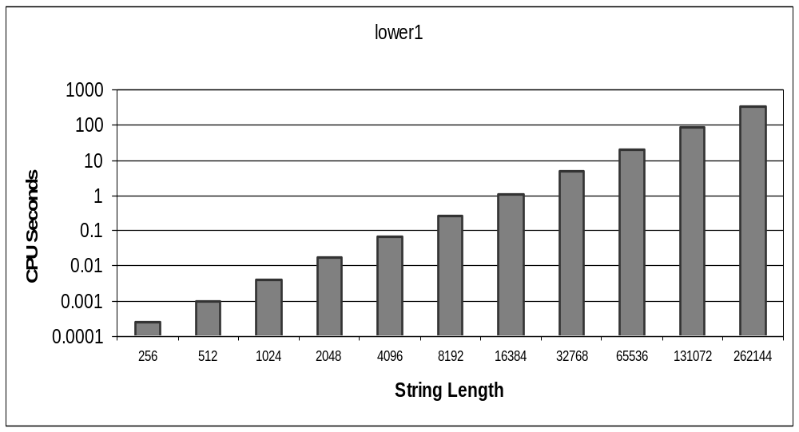
8.5 Example of Optimizing Program (13/24)
Time quadruples(四倍) when double string length
nonuniform
非均匀量化
201001V1.1
Notes:
注意CPU SECONDES非均匀坐标间隔
长度2倍，由于是2次项，则变成2^2=4倍时间

Slide 32
8.5 Example of Optimizing Program (14/24)
Move call to strlen outside of loop
  Since result does not change from one iteration to another
Form of code motion
void lower2(char *s)
{
int i;
int len = strlen(s);
for (i = 0; i < len; i++)
if (s[i] >= 'A' && s[i] <= 'Z')
s[i] -= ('A' - 'a');
}
201001V1.1

Slide 33
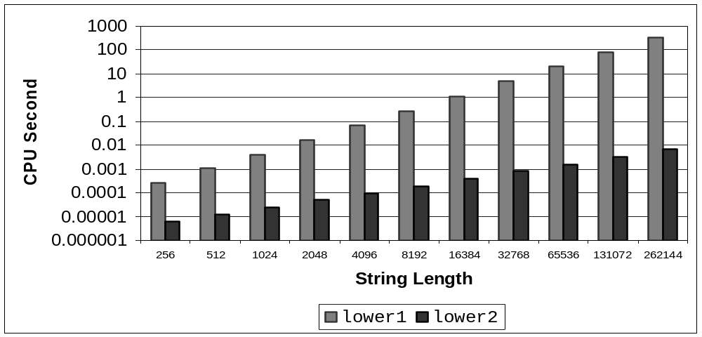
8.5 Example of Optimizing Program (15/24)
Time doubles when double string length
Linear performance
201001V1.1

Slide 34
8.5 Example of Optimizing Program (16/24)
Optimization: Reduction in Procedure Call
  Procedure calls are expensive!
void combine2(vec_ptr v, int *dest)
{
int i;
int length = vec_length(v);
*dest = 0;
for (i = 0; i < length; i++) {
int val;
get_vec_element(v, i, &val);
*dest = *dest OP val;
}
}
201001V1.1

Slide 35
8.5 Example of Optimizing Program (17/24)
Improvement : Avoid procedure call to retrieve each vector element
  Get pointer to start of array before loop
  Within loop just do pointer reference
  Not as clean in terms of data abstraction
201001V1.1

Slide 36
8.5 Example of Optimizing Program (18/24)
data_t* get_vec_start(vec_ptr v)
{
return v->data;
}
void combine3(vec_ptr v, int *dest)
{
int i;
int length = vec_length(v);
data_t *data = get_vec_start(v);
*dest = 0;
for (i = 0; i < length; i++) {
*dest = *dest OP data[i];
}
CPE: 6.00
201001V1.1
Notes:
可能会损害程序的模块性 每次用v->data[i]那么引用也比较费时

Slide 37
8.5 Example of Optimizing Program (19/24)
Overview *dest += data[i]; // (4 yellow lines)
*dest += data[i];
00401159 8B 55 0C mov edx,dword ptr [ebp+0Ch] // edx = dest
0040115C 8B 02 mov eax,dword ptr [edx] // eax = *dest
0040115E 8B 4D FC mov ecx,dword ptr [ebp-4] // ecx = i
00401161 8B 55 F4 mov edx,dword ptr [ebp-0Ch] // edx = data
00401164 03 04 8A add eax,dword ptr [edx+ecx*4] // eax = eax + data[i]
00401167 8B 4D 0C mov ecx,dword ptr [ebp+0Ch] // ecx = dest
0040116A 89 01 mov dword ptr [ecx],eax // *dest = eax
201001V1.1
Notes:
p335

Slide 38
8.5 Example of Optimizing Program (20/24)
Optimization: Eliminate Unneeded Memory References
  Don’t need to store in destination until end
  Local variable acc held in register
  Avoids 1 memory read, 1 memory write per cycle
  Memory references are expensive!
void combine4(vec_ptr v, int *dest)
{
int i;
int length = vec_length(v);
data_t *data = get_vec_start(v);
data_t acc = 0;
for (i = 0; i < length; i++)
acc =acc OP data[i];
*dest = acc;}
CPE: 2.00
201001V1.1
Notes:
从直接的数据访问到积累在临时变量中

Slide 39
8.5 Example of Optimizing Program (21/24)
Assembly Code after Optimization (2 yellow lines)
004011D7 8B 4D FC mov ecx,dword ptr [ebp-4] // ecx = i
004011DA 8B 55 F4 mov edx,dword ptr [ebp-0Ch] // edx = data
004011DD 8B 45 F0 mov eax,dword ptr [ebp-10h] // eax = sum
004011E0 03 04 8A add eax,dword ptr [edx+ecx*4] // eax = eax +data[i]
004011E3 89 45 F0 mov dword ptr [ebp-10h],eax // sum = eax
201001V1.1

Slide 40
8.5 Example of Optimizing Program (22/24)
Reducing Loop Overhead
  Unrolling Loop by 3
void combine5(vec_ptr v, data_t *dest)
{
int i; int length = vec_length(v);
int limit = length-2;
data_t *data = get_vec_start(v);
data_t acc = 0;
for (i = 0; i < limit; i+=3) {
acc =( (acc OP data[i] )OP data[i+1] ) OP data[i+2] ;
for (; i < length; i++)
acc = acc OP data[i];
*dest = acc;
}
CPE: 1.00
201001V1.1
Notes:
让编译器展开循环，目前优化级别够高，就可以做到，比如GCC –funroll -loops

Slide 41
8.5 Example of Optimizing Program (23/24)
Unrolling Loop by 2 and Using Two-Way Parallelism.
void combine6(vec_ptr v, data_t *dest)
{
int i; int length = vec_length(v);
int limit = length-1;
data_t *data = get_vec_start(v);
data_t acc0= 0, acc1= 0;
for (i = 0; i < limit; i+=2) {
acc0 =acc0 OP data[i] ;
acc1 = acc1 OP data[i+1];}
for (; i < length; i++)
acc0 = acc0 OP data[i];
*dest = acc0 OP acc1;
}
Fig 5.20 5.25
Float CPE improved
May get different result
201001V1.1
Notes:
对整数结果相同，但引入并行形式的编译器较少

Slide 42
8.5 Example of Optimizing Program (24/24)
Change associativity of combining operation
void combine7(vec_ptr v, data_t *dest)
{
int i; int length = vec_length(v);
int limit = length-1;
data_t *data = get_vec_start(v);
data_t acc = 0;
for (i = 0; i < limit; i+=2) {
acc =acc OP (data[i] OP data[i+1] ) ;
for (; i < length; i++)
acc = acc OP data[i];
*dest = acc;
}
Similar to combine6
201001V1.1

Slide 43
Unit 8. Optimizing Program Performance
8.1 Introduction of Optimizing Program
8.2 The Golden Rules of Optimization
8.3 Optimizing Compilers
8.4 General Optimization Techniques
8.5 Example of Optimizing Program
201001V1.1

Slide 44
8.4 General Optimization Techniques (1/2)
Reference:
  How To Optimize C/C++ Source - Performance Programming, Based by Sachin Garg
201001V1.1

Slide 45
8.4 General Optimization Techniques (2/2)
The Clicking Optimizations
Faster Mathematics
Faster Loops
Avoiding Expression Repetitions
Using Assembly
Using register
Integers
Pointer Dereferencing
Avoiding Temporary Variables
String Comparisons
Pre vs. Post Increment/Decrement
Call by Value vs. Call by Reference
Don't Reallocate, But Reuse
Use switch() instead of if...else...
Early loop breaking
Other Suggestions
201001V1.1

Slide 46
The Clicking Optimizations
This tip can be applied to any language you are using for development.
You won't have to write or modify any code to get these gains, only mouse clicks are required.
Some compilers can generate code for common tasks saving you a lot of effort.
  choose to optimize EXE either for speed or for size.
  Remove the debugging information from the EXEs saving a lot of space and making it more difficult to reverse engineer your program. Release version, not debug version
  Use a profiler to track down execution time
201001V1.1

Slide 47
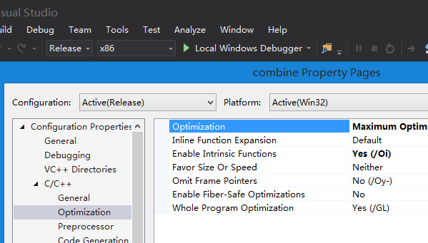
The Clicking Optimizations
201001V1.1

Slide 48
Faster Mathematics
Simplifying Expressions
  Replace costly operation with simpler one
  Example:
    a*b + a*c =
    b/a + c/a
Faster Calculation Techniques
  Shift instead of multiply or divide
    x << y is same as x * 2^{y}
    x >> y is same as x / 2^{y}
    16*x -->
a*(b+c);//one *
= (1/a)*(b+c)
= (b+c)/a;//zero * and one /
x << 4
201001V1.1
Notes:
n/255 approximate n>>8,if n is big enough

Slide 49
Faster Loops
Loop Unrolling(循环展开)
  It is because the code has to check and increment the value of i.
  Example:
for(i=0; i<3; i++) {
something(i);
}
is less efficient than
something(0);
something(1);
something(2);
201001V1.1

Slide 50
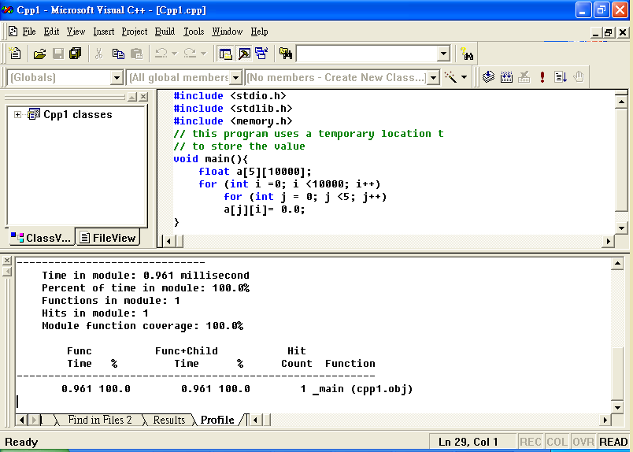
Example – Two “for loop” (0.961ms)
201001V1.1

Slide 51
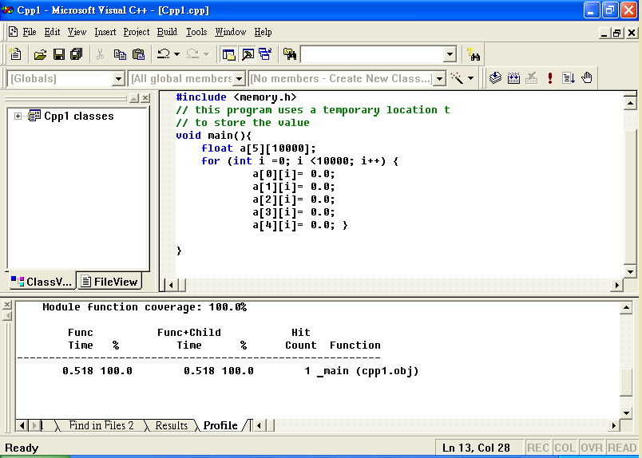
Example – One “for loop” (0.518ms)
201001V1.1

Slide 52
Loop Fusion
replaces multiple loops with a single one(recommend when data size is small or process is simple)
  Not use two loops where one is enough
for(i=0; i<100; i++)
{
stuff();
}
for(i=0; i<100; i++)
{
morestuff();
}
for(i=0; i<100; i++) {
stuff();
morestuff();
}
201001V1.1

Slide 53
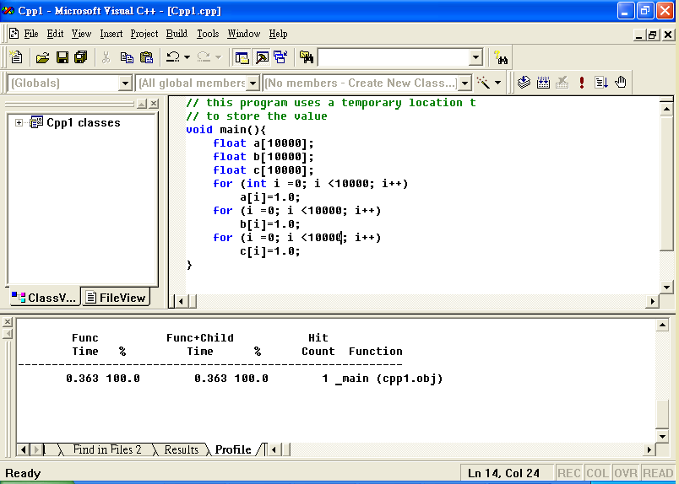
Example – Three loops (0.363ms)
201001V1.1

Slide 54
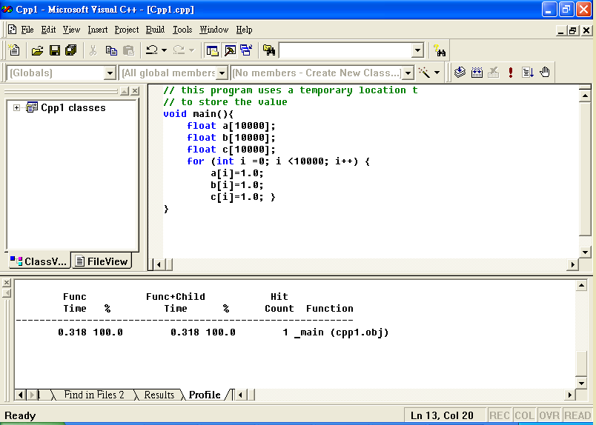
Example – One loop (0.31ms)
201001V1.1
Notes:
Cache hit ratio

Slide 55
Avoiding Expression Repetitions
common subexpression elimination (CSE)
If ( (dataStructPointer->ExpensiveFunctionCall()) < 10 ) {
//some code here
}
else if ( (dataStructPointer->ExpensiveFunctionCall()) > 30 ) {
// some code here
}
int temp = dataStructPointer>ExpensiveFunctionCall() ;
if(temp < 10) {
// some code here
}
else if(temp > 30) {
// some code here
}
201001V1.1

Slide 56
Using Assembly
void main() { int a, b, c,d; a=-11; b=3; c=a/b; d=a%b; }
5: c=a/b;
00401036 8B 45 FC mov eax,dword ptr [ebp-4] ;a
00401039 99 cdq
0040103A F7 7D F8 idiv eax,dword ptr [ebp-8] ;b
0040103D 89 45 F4 mov dword ptr [ebp-0Ch],eax ;c eax quotient
6: d=a%b;
00401040 8B 45 FC mov eax,dword ptr [ebp-4]
00401043 99 cdq
00401044 F7 7D F8 idiv eax,dword ptr [ebp-8]
00401047 89 55 F0 mov dword ptr [ebp-10h],edx ;d edx remainder
201001V1.1
Notes:
CDQ (convert double to quarter)指令. 它大多出现在除法运算之前. 它实际的作用只是把EDX的所有位都设成EAX最高位的值. 也就是说,当EAX <80000000, EDX 00000000; 当EAX >= 80000000, EDX 则为FFFFFFFF).
被除数: 默认放在 ax 或 dx 和 ax 中
则 ax 存储除法操作的商， dx 存储除法操作的余数

Slide 57
Using register
Use the "register" declaration whenever you can, eg.
  register float val;
  register double dval;
  register int ival;
In for loops, it is usually most appropriate to register the loop variables.
Registering the loop variable of inner most loop.
for ( int i = 0; i < 10; i++) {
for ( int j = 0; j < 10; j++) {
for ( register int k; k<10; k++) {
// Function body
}
}
}
201001V1.1
Notes:
但是使用register修饰符有几点限制。
首先，register变量必须是能被CPU所接受的类型。这通常意味着register变量必须是一个单个的值，并且长度应该小于或者等于整型的长度。不过，有些机器的寄存器也能存放浮点数。
其次，因为register变量可能不存放在内存中，所以不能用“&”来获取register变量的地址。
由于寄存器的数量有限，而且某些寄存器只能接受特定类型的数据（如指针和浮点数），因此真正起作用的register修饰符的数目和类型都依赖于运行程序的机器，而任何多余的register修饰符都将被编译程序所忽略。
在某些情况下，把变量保存在寄存器中反而会降低程序的运行速度。因为被占用的寄存器不能再用于其它目的；或者变量被使用的次数不够多，不足以装入和存储变量所带来的额外开销。
早期的C编译程序不会把变量保存在寄存器中，除非你命令它这样做，这时register修饰符是C语言的一种很有价值的补充。然而，随着编译程序设计技术的进步，在决定那些变量应该被存到寄存器中时，现在的C编译环境能比程序员做出更好的决定。实际上，许多编译程序都会忽略register修饰符，因为尽管它完全合法，但它仅仅是暗示而不是命令。

Slide 58
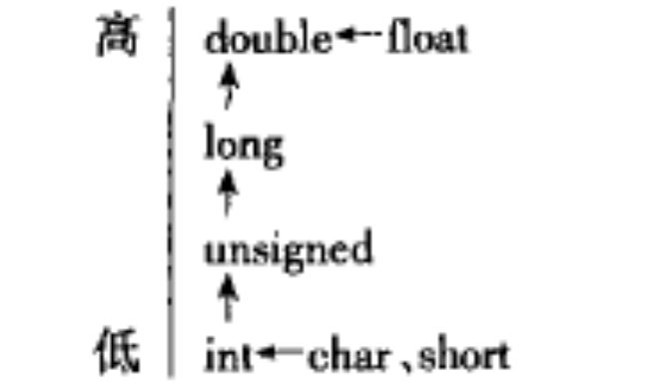
Integers
Use proper data type
  Use unsigned ints instead of ints if you know the value will never be negative.
    unsigned int a;
Integer arithmetic is faster than floating-point operation
201001V1.1
Notes:
符号扩展

Slide 59
Constant Folding
int c;
c = 12;
if (12 > 10) {
c = 2;
}
return c * 2;
return 4;
201001V1.1

Slide 60
Pointer Dereferencing
This saves a lot of time wasted in pointer dereferencing, the speed gains are a lot more than what you can imagine.
for( int i = 0; i < BigNum; i++ ) {
Inventory -> StuffToSell -> LowProfitStuff -> Count[i] = Value;
}
unsigned int *InventoryCount =
Inventory -> StyffToSell -> LowProfitStuff -> Count;
for( int i = 0; i < BigNum; i++ ) {
InventoryCount[i] = Value;
}
201001V1.1
Notes:
dereference间接引用
& 取地址运算符
-> 箭头运算符

Slide 61
Avoiding Temporary Variables
Second way is faster as here the compiler won't have to create any temporary objects.
But it seriously effects the code readability.
a += a1;
a += a2;
a += a3;
a = a + a1 + a2 + a3;
This seem expression 1 is simple
in assembly than expression 2
201001V1.1
Notes:
复合赋值符这种写法,十分有利于编译处理，能提高编译效率并产生质量较高的目标代码。

Slide 62
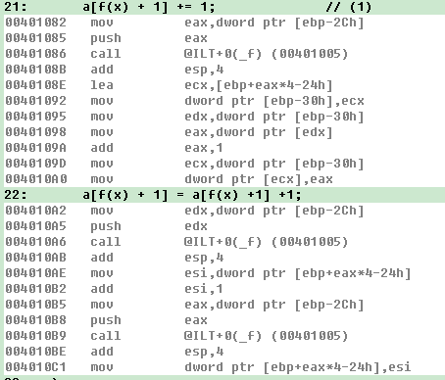
Avoiding Temporary Variables
Here, the combination assignment operator can avoid side effect in function call.
int a[10] = {0};
int x = 2;
a[f(x) + 1] += 1;
a[f(x) + 1] = a[f(x) +1] +1;
201001V1.1
Notes:
复合赋值符这种写法,十分有利于编译处理，能提高编译效率并产生质量较高的目标代码。

Slide 63
String Comparisons
The usual way is to compare each element and break out of the loop as soon as a different element is found.
First check if lengths match
  this usually gets 90% of inequalities
Checksum solution
  check if their checksums match
  check every char of the strings only if their checksums are equal.
The method is related to the length of array.
201001V1.1

Slide 64
String Comparisons
  unsigned char checksum = 0;
  char str[20];
  int len;
  len = strlen(str);
  //Get any string in str and the value of len.
  //str may contain any string - text or binary
  for(int i = 0; i < len; i++) {
  checksum += str[i];
  } //can we use int to improve it ? 4 bytes vs 1 byte
201001V1.1
Notes:
即便溢出也可以对剩余的4字节是否相等做比较

Slide 65
Strings
Microsoft Foundation Class (MFC) CString class allocates dynamic memory.
String manipulation is expensive in general whether it is
  formatting text as in printf
  reading ASCII text
  converting to numbers
  performing string comparisons
201001V1.1
Notes:
Modern computers are designed to access memory a word at a time. Accessing a character is no faster than accessing a word, and may be slower. String operations usually operate one character at a time, and even a simple function like strlen(), which computes the length of a string, has to examine every character, one at a time
String manipulation is expensive in general whether it is formatting text as in printf, reading ASCII text and converting to numbers, or performing string comparisons:strlen()
This is great if you want to avoid managing memory yourself and you want to avoid nasty bugs due to writing data beyond the end of allocated string memory.
On the other hand, if you find that memory allocation is taking significant time in an inner loop, you might want to consider allocating a fixed-length character array as local or static data.
STL就是Standard Template Library，标准模板库,从根本上说，STL是一些“容器”的集合，这些“容器”有list,vector,set,map等，STL也是算法和其他一些组件的集合。这里的“容器”和算法的集合指的是世界上很多聪明人很多年的杰作。 STL的目的是标准化组件，这样就不用重新开发，可以使用现成的组件。STL现在是C++的一部分，因此不用额外安装什麽。它被内建在你的编译器之内。

Slide 66
Pre vs. Post Increment/Decrement
Prefer pre-increment and -decrement to postfix operators.
  Postfix operators (i++) copy the existing value to a temporary object, increment the internal value, and then return the temporary.
  Prefix operators (++i) increment the value and return a reference to it.
201001V1.1
Notes:
自增运算符（Increment Operator）.
前自增：pre
后自增：post

Slide 67
Call by Value vs. Call by Reference
Passing arguments to a function by value
  e.g. void f(Type x)
  cheap for built-in types
  but potentially expensive for class types
Passing by address
  e.g. void f(Type* x) // const Type* x is a better way
  is light-weight
  but changes the way the function is called, and exposes the passed object to modification by the called function.
Passing by reference-to-const (常引用)
  e.g. void f (const double & x)
  combines the safety of passing by value with the efficiency of passing by address.
201001V1.1
Notes:
常引用
1）使用const修饰符也可以说明引用，被说明的引用为常引用，该引用所引用的对象不能被更新。其定义格式如下：
const <类型说明符> & <引用名> 例如： const double & v;
2）在实际应用中，常指针和常引用往往用来作函数的形参，这样的参数称为常参数。
3）在C++面向对象的程序设计中，指针和引用使用得较多，其中使用const修饰的常指针和常引用用得更多。使用常参数则表明该函数不会更新某个参数所指向或所引用的对象，这样，在参数传递过程中就不需要执行拷贝初始化构造函数，这将会改善程序的运行效率。

Slide 68

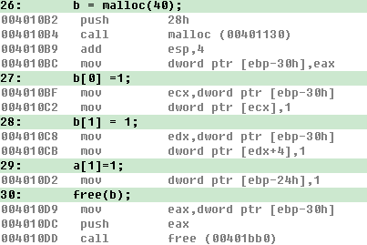
Deal with malloc()
malloc (or new in C++) is expensive.
A common solution
  1. is to use static or local variables to avoid allocating memory on the heap.
int a[10];
int x = 2;
int *b;
b = malloc(40);
b[0] =1;
b[1] = 1;
a[1]=1;
free(b);
201001V1.1

Slide 69
Deal with malloc()
A common solution
  2.Another solution is to keep a list of objects that need to be allocated often. Then, allocation is just a matter of removing an object from the list, and freeing simply inserts the object on the list
Better not to use malloc()
201001V1.1

Slide 70
Example in Tutorial (1)
#include "iostream.h"
class Myobject {
public:
static Myobject *alloc();
void free();
protected:
Myobject *next;
//used for allocation
static Myobject *freelist;
long x; // your member variables
long y; // etc.
};
// declare and initialize empty free list:
Myobject *Myobject::freelist = NULL;
Myobject *Myobject::alloc() {
Myobject *p;
//fast allocation:
//pop object from freelist
if (freelist) {
p = freelist;
freelist = freelist->next;
}
else {
p = new Myobject;
}
return p;
}
void Myobject::free() {
this->next = freelist;
freelist = this; }
Where to free the freelist ?
201001V1.1
Notes:
静态成员函数在创建对象之前都可以先处理静态数据成员，这点是普通成员函数所不能实现的；还有静态成员函数主要用来访问全局变量和静态数据成员，
尤其是和静态数据成员配合使用的适合，可以实现数据的共享
注意，static数据成员不是通过类构造函数进行初始化的,要初始化的话必须在类外进行定义

Slide 71
Example in Tutorial (2)
// quick test and demonstration:
void main() {
Myobject *a[10];
cout << "Allocated: ";
for (int i = 0; i < 10; i++) {
a[i] = Myobject::alloc();
cout << a[i] << " ";
}
cout << endl;
// free the even-numbered objects:
cout << "Freed: ";
for (i = 0; i < 5; i++) {
cout << a[i * 2] << " ";
a[i * 2]->free();
}
cout << endl;
// reallocate the
// even-numbered objects:
cout << "Allocated: ";
for (i = 0; i < 5; i++) {
a[i * 2] = Myobject::alloc();
cout << a[i * 2] << " ";
}
cout << endl;
freelist ???
}
Allocated: 0x00780D90 0x00780D50 0x00780D10 0x00780CD0 0x00780C90 0x00780C50 0x00780420 0x007803E0 0x007803A0 0x00780360
Freed: 0x00780D90 0x00780D10 0x00780C90 0x00780420 0x007803A0
Allocated: 0x007803A0 0x00780420 0x00780C90 0x00780D10 0x00780D90
201001V1.1

Slide 72
Don't Reallocate, But Reuse
Memory allocation/deallocation takes a lot of time, it is better to reuse already allocated chunks of memory rather than deallocate them and then allocating new memory.
Also, if you are allocating memory repeatedly for "small" objects, it is better to first allocate a large memory chunk and manage you small objects inside it.
These objects must have the same size.
201001V1.1

Slide 73
malloc() in printf
printf causes malloc to be called in the usual implementation.
  This can add an unexpected cost.
  Better not to use printf()
puts, printf都是输出到stdout, puts输出无格式字符串; printf根据format string 中的标记进行格式化输出
Use puts()
201001V1.1
Notes:
puts, printf都是输出到stdout, puts输出无格式字符串; printf根据format string 中的标记进行格式化输出

Slide 74
Use switch() instead of if...else...
For large decisions involving if…else if...else..., it may be faster to use a switch: GCC
switch( val ) {
case 1: dostuff1(); break;
case 2: dostuff2(); break;
case 3: dostuff3(); break;
}
if( val == 1)
dostuff1();
else if (val == 2)
dostuff2();
else if (val == 3)
dostuff3();
201001V1.1
Notes:
Binarybomb 第4个实验可以看到表
Vc6.0下调试状态未见该表，网络资料表示GCC不开优化可以得出该表
switch...case与if...else的根本区别在于，switch...case会生成一个跳转表来指示实际的case分支的地址，而这个跳转表的索引号与switch变量的值是相等的。从而，switch...case不用像if...else那样遍历条件分支直到命中条件，而只需访问对应索引号的表项从而到达定位分支的目的。
具体地说，switch...case会生成一份大小（表项数）为最大case常量＋1的跳表，程序首先判断switch变量是否大于最大case 常量，若大于，则跳到default分支处理；否则取得索引号为switch变量大小的跳表项的地址（即跳表的起始地址＋表项大小＊索引号），程序接着跳到此地址执行，到此完成了分支的跳转。

Slide 75
Early loop breaking
found = FALSE;
for(i=0;i<10000;i++) {
if( list[i] == -99 ) {
found = TRUE;
}
}
if( found )
printf("Yes, there is a -99. \n");
found = FALSE;
for(i=0; i<10000; i++) {
if( list[i] == -99 ) {
found = TRUE;
break;
}
}
if( found )
printf("Yes, there is a -99. \n");
201001V1.1

Slide 76
Suggestion (1)
Declare anything within a file (external to functions) as static, unless it is intended to be global. (accessed only in this file)
Don't use recursion. Recursion can be very elegant and neat, but creates many more function calls which can become a large overhead.
Avoid the sqrt() square root function in loops - calculating square roots is very CPU intensive.
Single dimension arrays are faster than multi-dimensioned arrays. (a[16] is better than a[4][4])
201001V1.1
Notes:
Static 只能被本文件访问

Slide 77
Suggestion (2)
Single precision maths may be faster than double precision - there is often a compiler switch for this. (float is better than double unless you really want it.)
Floating point multiplication is often faster than division - use val * 0.5 instead of val / 2.0.
Addition is quicker than multiplication - use val + val + val instead of val * 3
puts() is quicker than printf(), although less flexible.
201001V1.1
Notes:
Text book 359 Chinese edition, 单精度和整型，CPU每周期4个合并操作，而double，只有2个。

Slide 78
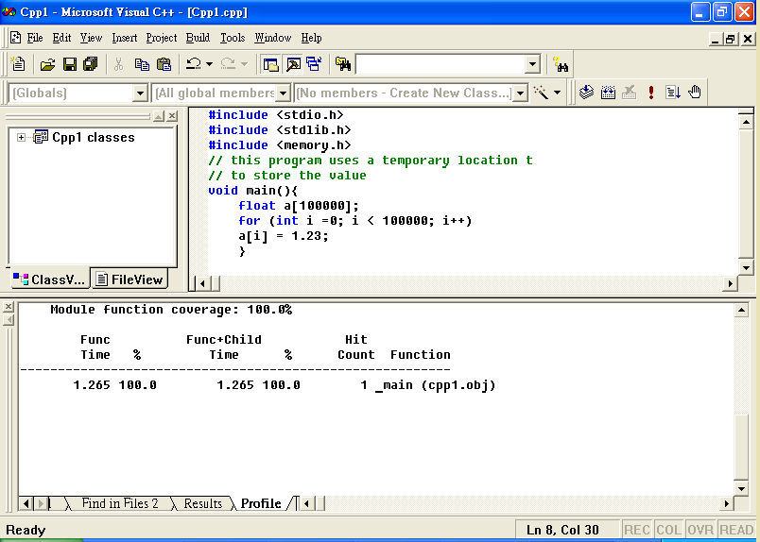
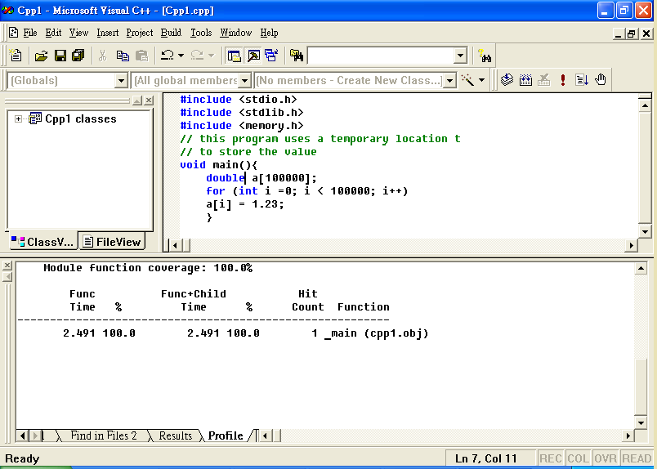
Example - float (4 bytes) and double (8 bytes)
2.49
1.26
201001V1.1

Slide 79
Suggestion (3)
Use #defined macros instead of commonly used tiny functions
  Replacing it with a macro to perform the same job will remove the overhead of all those function calls, and allow the compiler to be more aggressive in it's optimization.
Binary/unformatted file access is faster than formatted access
  as the machine does not have to convert between human-readable ASCII and machine-readable binary.
  If you don't actually need to read the data in a file yourself, consider making it a binary file.
201001V1.1

Slide 80
Loop
《高质量C++编程》
在多重循环中，如果有可能，应当将最长的循环放在最内层，最短的 循环放在最外层，以减少 CPU 跨切循环层的次数。下例的效率比上例高。
for (row=0; row<100; row++) {
  for ( col=0; col<5; col++ ) {
sum = sum + a[row][col]; } }
for (col=0; col<5; col++ ) {
for (row=0; row<100; row++) {
sum = sum + a[row][col]; } }
201001V1.1
Notes:
下一种写法，程序猜100次才，有一次猜错；而而上一次没猜5次就1次猜错，打断了流水线

Slide 81
Loop
如果循环体内存在逻辑判断，并且循环次数很大，宜将逻辑判断移到循环体的外面。
例(c)例(d)多执行了N-1 次逻辑判断。
由于前者老要进行逻辑判断，打断了循环“流水线”作业，使得编译器不能对循环 进行优化处理，降低了效率。
如果N 非常大，最好采用(d)的写法，以提 高效率。如果N 非常小，两者效率差别并不明显，采用示(c)的写法比较好， 因为程序更加简洁
201001V1.1

Slide 82
Loop
C:
for (i=0; i<N; i++) {
if (condition) DoSomething();
else DoOtherthing(); }
D:
if (condition) {
for (i=0; i<N; i++) DoSomething(); }
else {
for (i=0; i<N; i++) DoOtherthing(); }
201001V1.1

Slide 83
Loop
From left to right, so put the most rigid严格的 condition on left.
if(f(2) > 1 || f(1) > 1)//judge f(2) first ,if success ,execute a[1]=0;
a[1] =0;
201001V1.1

Slide 84
Summary
optimality
slowly but surely
short and sweet
efficiency
too little, too late
quick and dirty
201001V1.1

